Slide 1


ZARA
Team 7
Arham Anwar
Arnav Gupta
Kazuya Hayashi

Slide 2

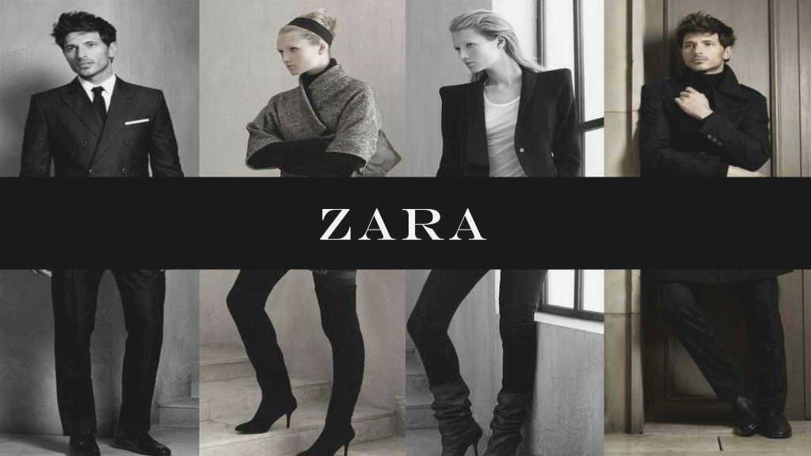


PROBLEM STATEMENT
One of the top fast fashion retailers, Zara, deals with the problem of customer option overload as well as significant seasonal dead stock creation.
Objective: to create a chatbot that offers personalized fashion recommendations and efficiently resolves inventory-related challenges faced by both customers and the Zara team.

Slide 3
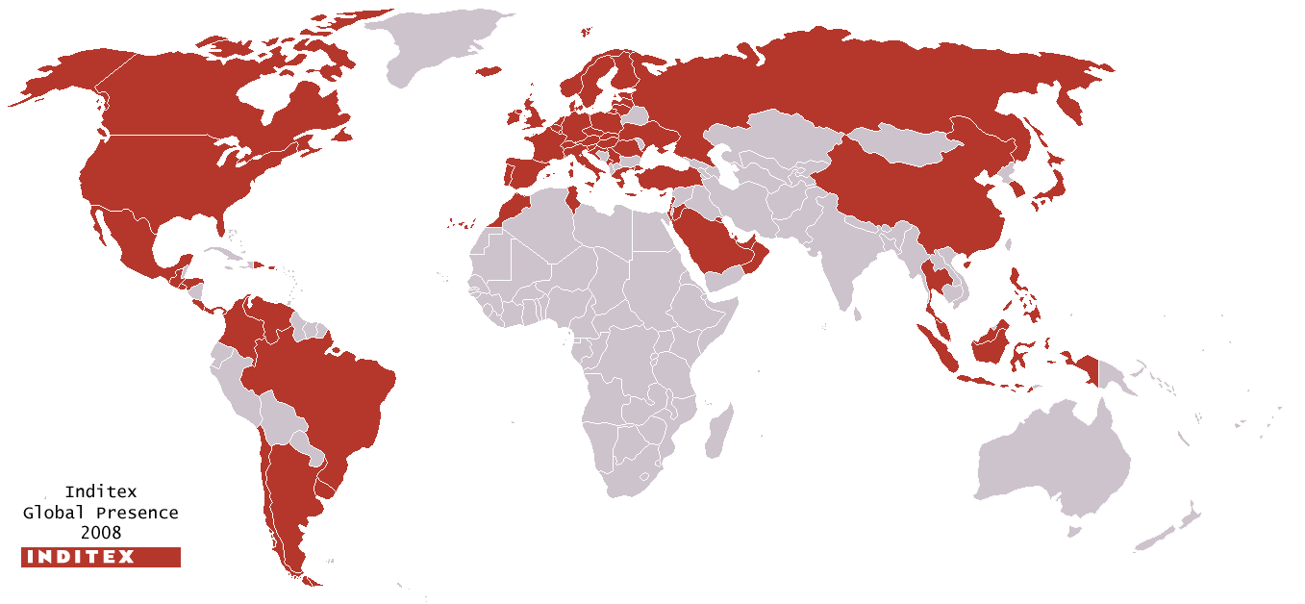
Company Description
11%
Market Share
500+
New Designs/Week
4000+
Stores
96
Countries
26.7%
Deadstock Ratio
Founded in Spain in 1974
Market leader in fast fashion industry (11% share)
Target: fashion-conscious individuals who seek trendy & affordable clothing options
500 new designs a week, or about 20,000 different styles a year
4000+ stores in 96 countries worldwide

Slide 4



RATIONALE
Zara's success stems from its efficient supply chain, delivering stylish garments at competitive prices through pioneering the fast fashion model.
A simple service chatbot only helps current maintenance but is unable to help innovate advance strategy as its not fully bilateral.
Our chatbot has been reimagined to create a common link between the employer as well as the customer.
Thus, it can analyze as well as generate data to help the following –
Tailored Fashion recommendations (better conversion rate)
Cross-sales and upselling through event based recommendations and complementary item suggestions
Improve dead stock movement
Influencer Collaboration and sentiment validation
Insights
Dead Stock Push
Data
Recommendations

Slide 5
LIBRARY DICTIONARY
LIBRARY | PURPOSE | INSTALLATION COMMAND
xlrd | Excel file reading | !pip install xlrd
openpyxl | Excel file manipulation | !pip install openpyxl
pandas | Data manipulation and analysis | !pip install pandas
plotly | Interactive data visualization | !pip install plotly
wget | File downloading | !pip install wget
requests | HTTP requests | import requests
BeautifulSoup | HTML parsing | from bs4 import BeautifulSoup
matplotlib.pyplot | Data visualization | import matplotlib.pyplot as plt
matplotlib.ticker | Customizing tick formats on plots | import matplotlib.ticker as mtick
seaborn | Enhanced data visualization | import seaborn as sns
PIL (Image module) | Image manipulation | from PIL import Image
io.BytesIO | In-memory binary I/O | from io import BytesIO
nltk | Natural language processing | import nltk
nltk.tokenize.word_tokenize | Tokenizing words | from nltk.tokenize import word_tokenize
nltk.corpus.stopwords | Stopwords for text processing | from nltk.corpus import stopwords
IPython.display | Rich content display in IPython | from IPython.display import display
fuzzywuzzy | String matching and similarity | from fuzzywuzzy import fuzz, process
tabulate | Tabular data formatting and display | from tabulate import tabulate
plotly.graph_objects | Low-level interface for creating plots | import plotly.graph_objects as go

Slide 6
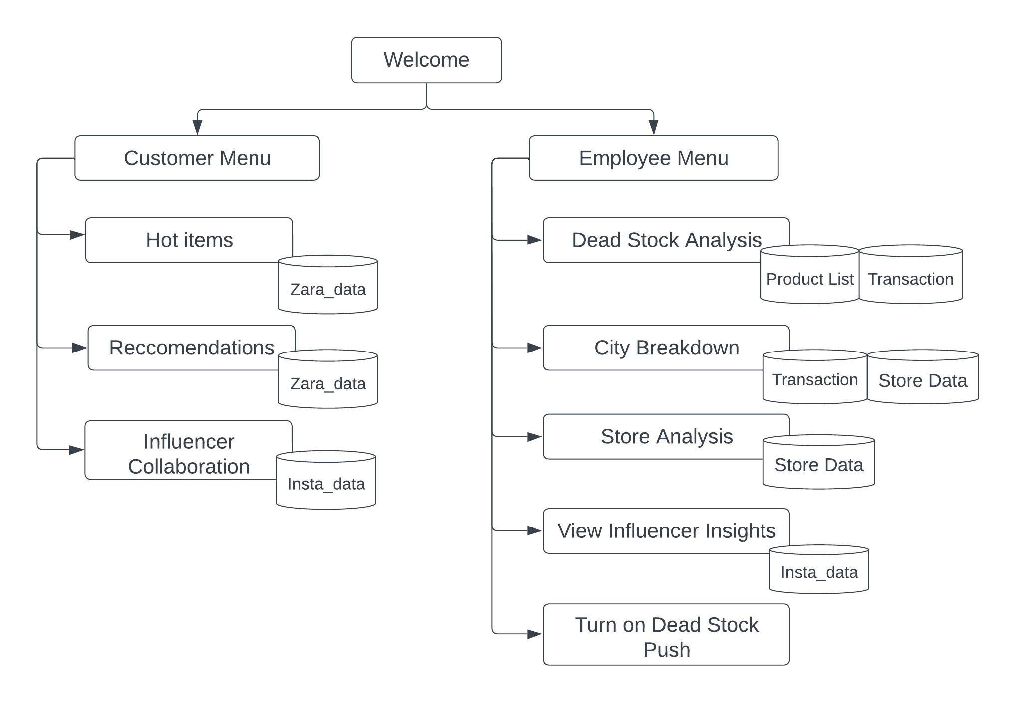
Overall Architecture

Slide 7
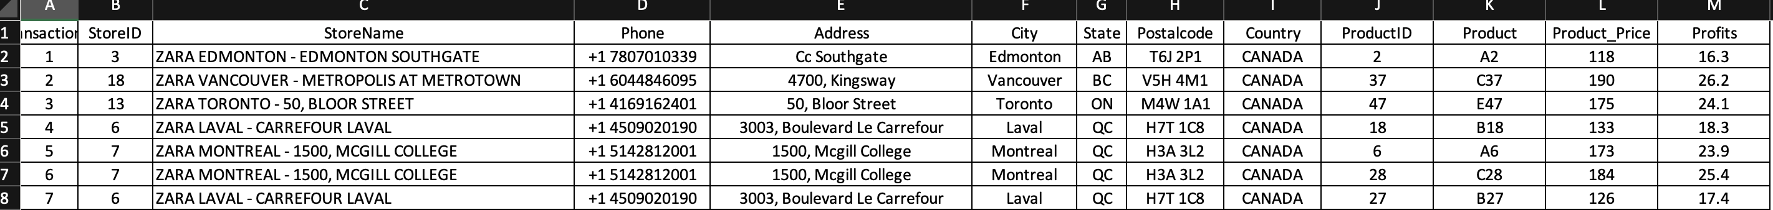
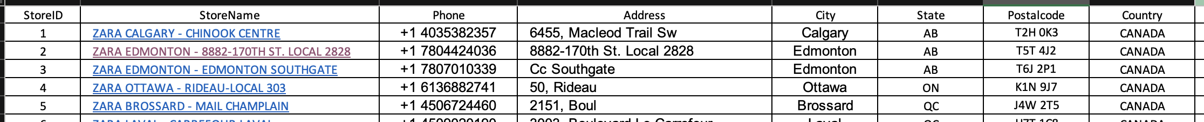
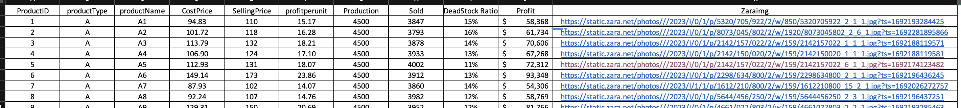
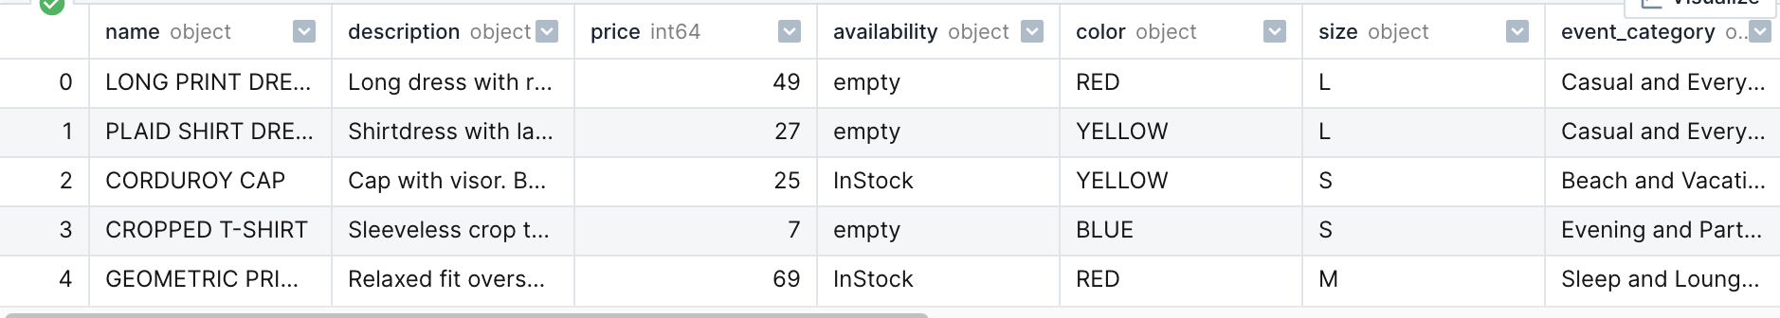
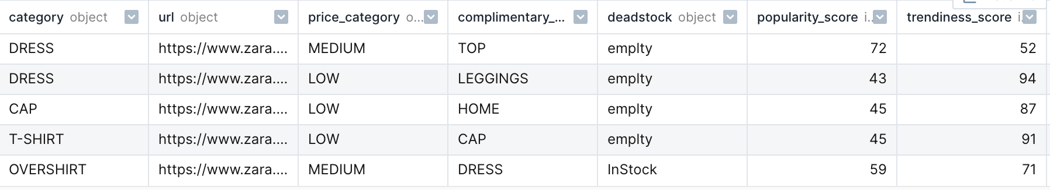
DATASETS
Transactional dataset: 201000 x 21 data entries, Source [3], Anonymized dataset from previous job converted to Zara dataset
Store Dataset: 19 x 10 data entries, Source [2], Scope is Canadian Zara stores as of 2019
Product List dataset: 60 x 11 data entries, Source[1], Images directly from Zara website
Influencer Dataset: 40 x 11 data entries, Source[4]
Recommendation Dataset: 1112 x 14 data entries, Source[4]

Slide 8
SCENARIO BRANCHES
Top SKUs by Deadstock
Chatbot Menu
Last SKUs by Deadstock
Deadstock Recomm.
Recommendation
Top SKUs by
Sales
Employee
Menu
Customer Menu
Hot Items
Color
Input
Size Input
Price Input
Last SKUs by
Sales
Deadstock Push
Employee Check
Event Based Recomm.
Event input
Color
Input
Size Input
Price Input
City Analysis
Employee Login
Influencer Collab
Store Analysis
View Correlation map
Influencer Analysis
Profile analysis
Collab Procedures
View top 10 influencers
Legend
Menu
Process
Scenario Node

Slide 9
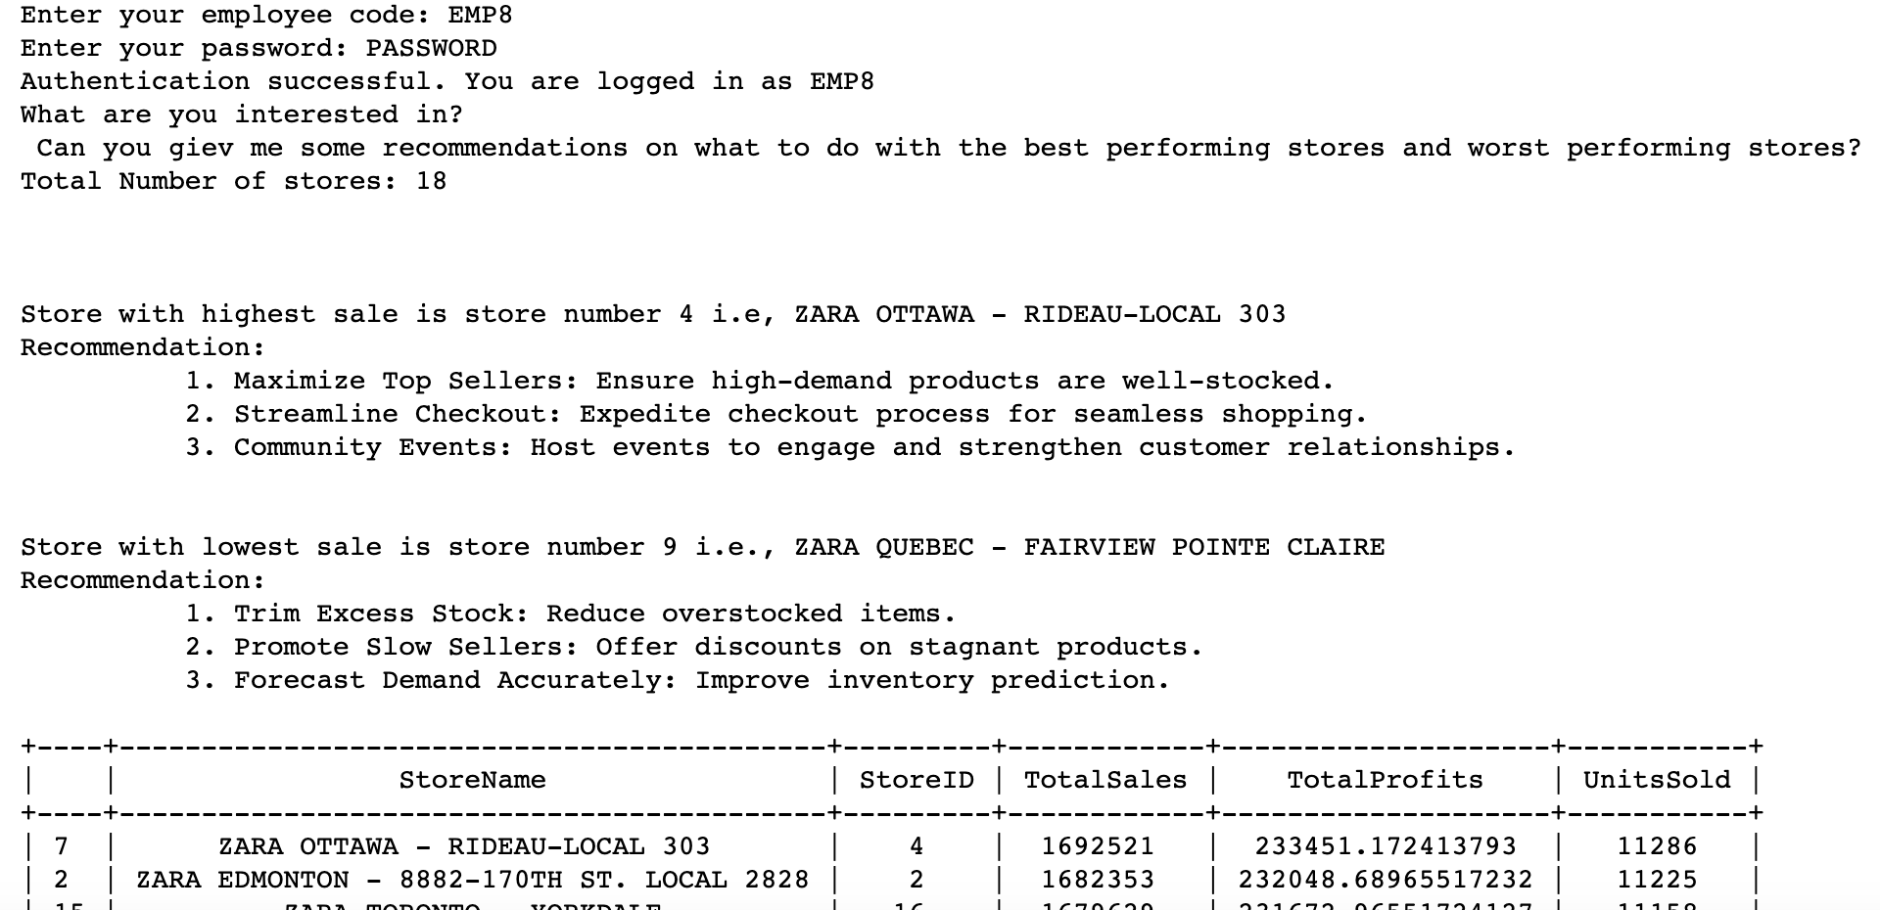

SCENARIO NODE:
SAVING LEVER RECOMMENDATION
Bot gives the sales manager
from transactional data
Recommends
to the sales manager
Insights
Next Steps

Slide 10

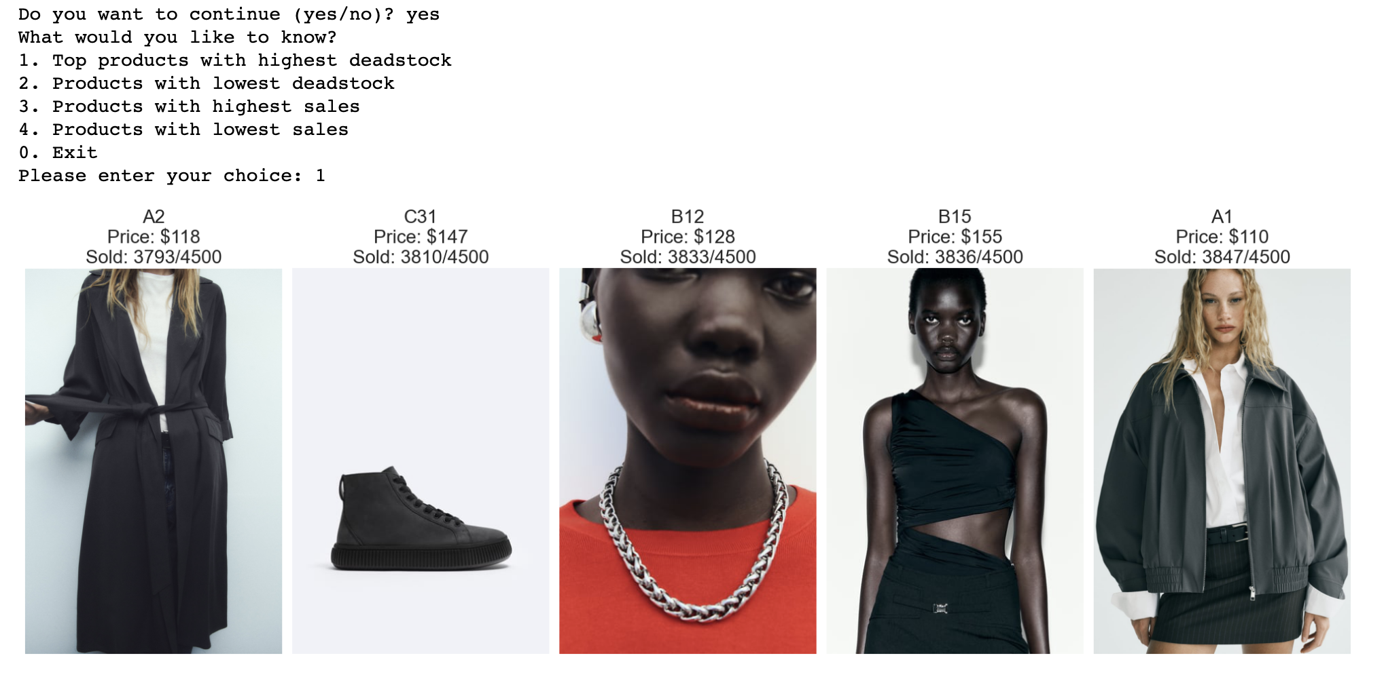



SCENARIO NODE:
DEADSTOCK PREDICTION BY ‘SKU’
Identify SKUs not doing well
in the national supply chain
And products that are doing well

Slide 11
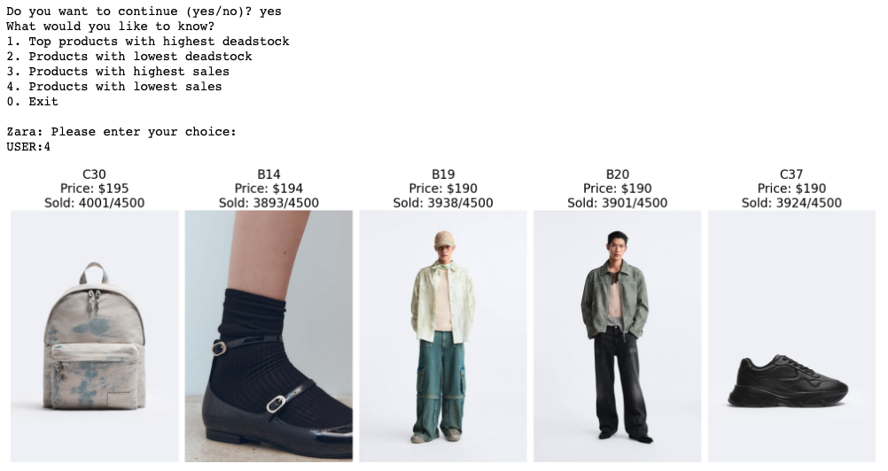
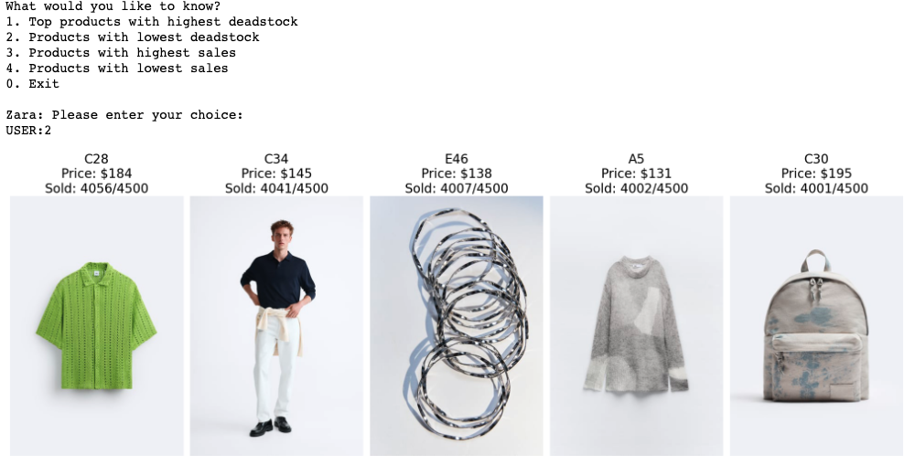
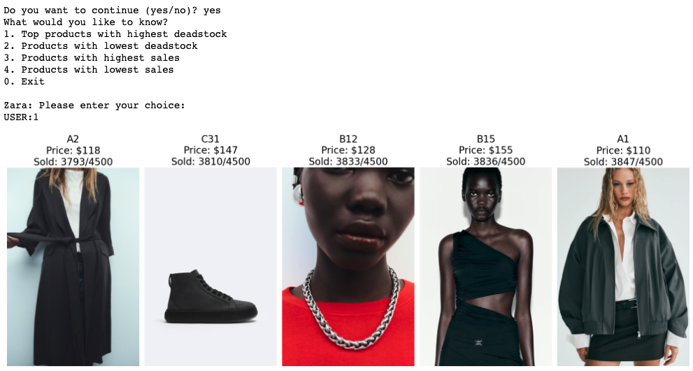
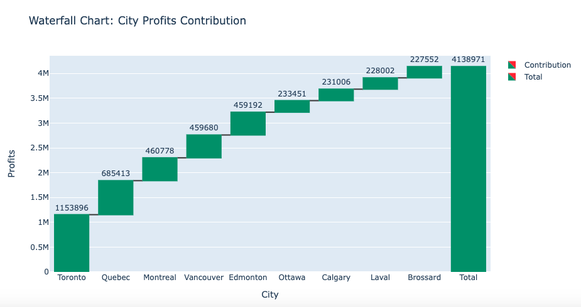
SCENARIO NODE:
SKU ‘HOT LIST’ ACTIVATION
02
Breakdown by geography to isolate problem geographically if there is any correlation with geography. E.g. Montreal being more fashion leaning, is more likely to reject SKUs out of trend
01
‘Dumpstock Push’ Feature lets the sales managers push products to ’hot items’ or ‘discount items’ to mitigate the bullwhip effect, wherein the items list can be retrieved from the sku analysis function

Slide 12


SCENARIO NODE:
ITEM RECOMMENDATION - CUSTOMER
1: Event Based
2: HOT ITEM
The bot provides guides users to find the perfect outfit for a specific event based on their preferences
It asks for the type of events and user preferences such as color, size, and price
It filters the data and find one item to recommend. Additionally, it finds items that complement the recommended item, utilizing the user preference it obtained
The bot provides recommendations for trendy clothing items based on user preferences
It prompts the user for their preferred color, size, and price range for clothing items
It sorts the filtered items by popularity and trendiness scores in descending order.
Recommends the top-rated item to the user, considering popularity and trendiness scores.

Slide 13
SCENARIO NODE:
EVENT BASED RECOMMENDATION - CUSTOMER
Preparing for a Casual Outing
Filter Items:
Select items that match with user preferences. If the ”deadstock switch” is on, filters out other items here
Bot: "Hello! What's the occasion you're dressing up for?"
User Input: "Just a casual hangout with friends."
+ recommending item
Find Complimentary Items:
It searches for items with the same event category, matching color, and size as the recommended item
+ identify the event
Output:
"Great! It looks like you're attending a 'Casual and Everyday Wear' event."
+ complimentary item
+ get user preferences
Here is our recommendation:
You might also be interested in this:
User Input:
Preferred color: "Blue"
Preferred size: "Medium"
Preferred price range: "Medium"
Recommendation:
Name: Casual Denim Jacket
Size: Medium
Color: Blue
Price: $35
URL: [Link to Item]
Complementary Item:
Name: Graphic Print T-Shirt
Size: Medium
Color: Blue
Price: $25
URL: [Link to Item]

Slide 14
SCENARIO NODE:
HOT ITEM RECOMMENDATION - CUSTOMER
Scenario: Exploring Trendy Clothing Recommendations
Output:
Thank you for providing your preference!
Let's find you some trendy items that match preferences
User: "I'm looking for some trendy clothing options. Can you help?”
+ get user preferences
+ Identify trendy item
Sort the filtered items by popularity and trendiness scores
Check if there are matching items that meet the user's preferences.
Output:
Let's get started! Please provide your preferences:”
User Prompt:
<shows available colors> What's your preferred color?"
<shows available sizes> What's your preferred size?"
<shows available price range > What's your preferred price range?"
+ recommending item
Output:
I recommend 'Stylish Denim Jacket' by Zara!
Description: Stay trendy with this stylish denim jacket featuring a modern design
Price: $75
Category: Outerwear
You can check it out here.
+ Filter Items
Select items that match with user preferences. If the ”deadstock switch” is on, filters out other items here

Slide 15
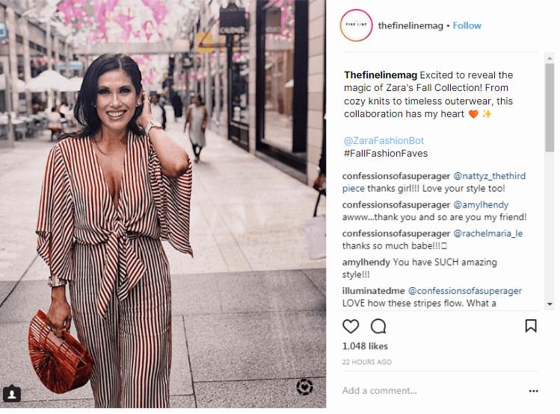
SCENARIO NODE:
INFLUENCER COLLABORATION - CUSTOMER
One of the features of the chatbot allows the customer to apply for collaborations to promote the brand.
The bot looks up the Instagram name and checks if they are above a certain score threshold. Then it figures out the country and weather to match the zara collection – summer ,fall, winter or spring.
The bot then gives them a suggestion to post and makes sure they tag @ZaraFashionBot – which then allows the bot to gather sentiment data from their posts’ comments.

Slide 16

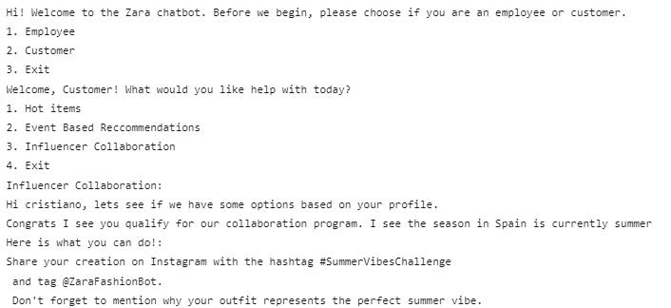
SCENARIO NODE:
INFLUENCER COLLABORATION - CUSTOMER

Slide 17
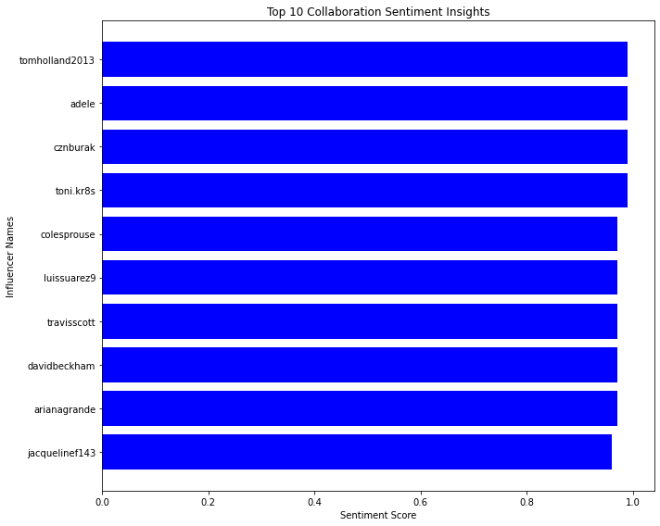
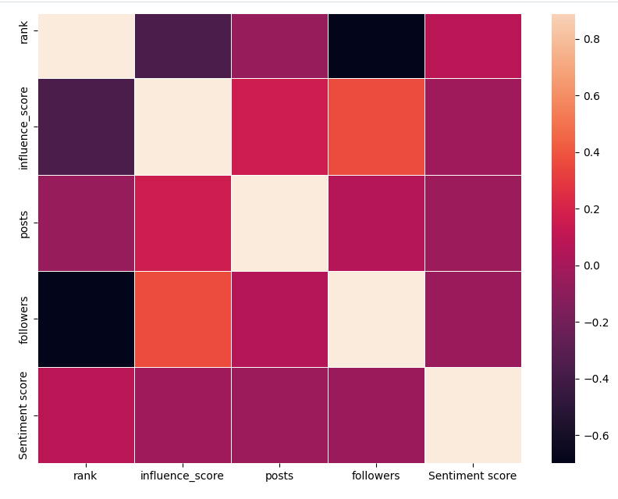
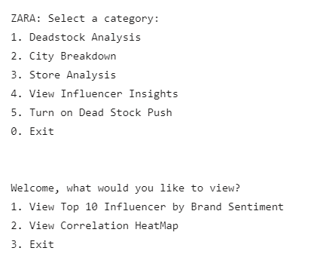
SCENARIO NODE:
INFLUENCER INSIGHTS (EMPLOYEE)
Moving on to the other side, this data can then be used by employees to assess market penetration through influencer performance.
They can look at the Top 10 influencers that give Zara the best sentiment.
They can also look at a heatmap of how their Brand sentiment is correlated to multiple social media factors such as influence score, number of posts, followers etc.

Slide 18
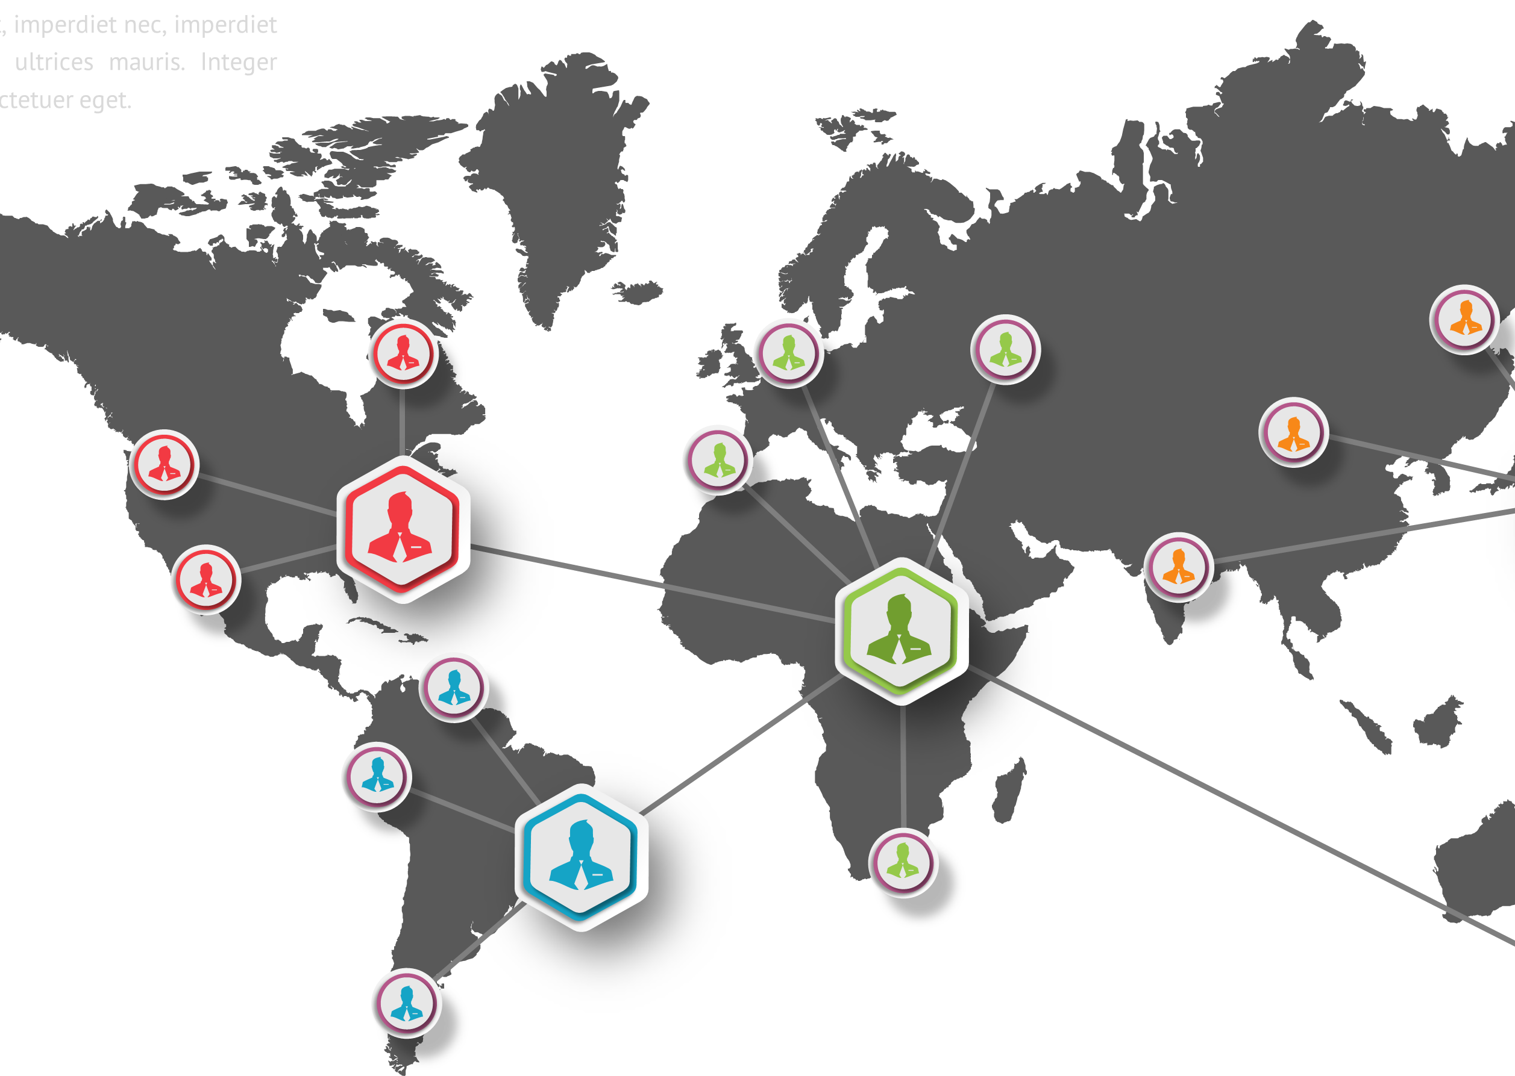
Future Suggestions
Segmentation Training - Chatbot can be trained based on region and customer segmentation using a neural network approach. This will tailor interactions better and provide faster and more effective conversion rates.
LLM Wrapper – The chatbot can be wrapped in a Large language model like Llama 2 or ChatGPT. This will provide much better user interaction as well as contextual understanding.
Image Recognition – Users can be given an option to upload images of clothes they like and the chatbot can find similar products based on it.
Augmented Reality – That chatbot can be further developed to provide a virtual wardrobe. The user can then try out different outfits using augmented reality.

Slide 19


LIVE CODE DEMO (LINK)

